Slide 1

Getting started with JWT
- Dinesh Pabbi

Slide 2
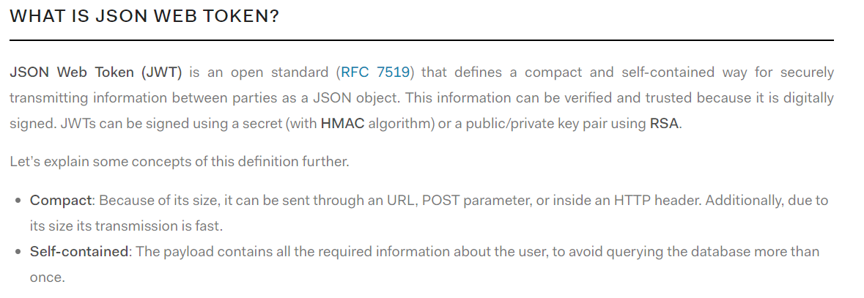

Slide 3
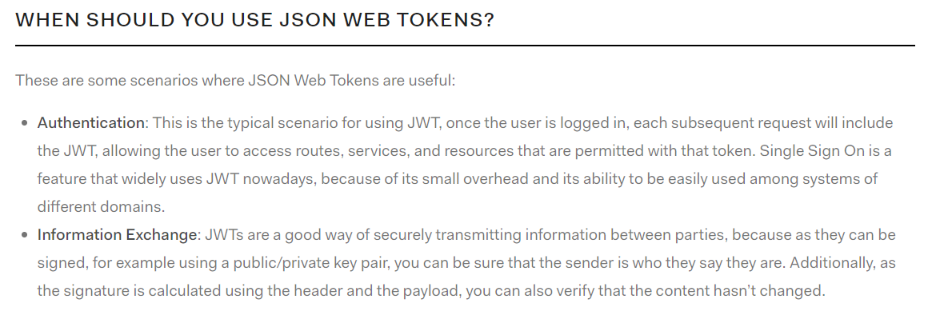

Slide 4


Slide 5
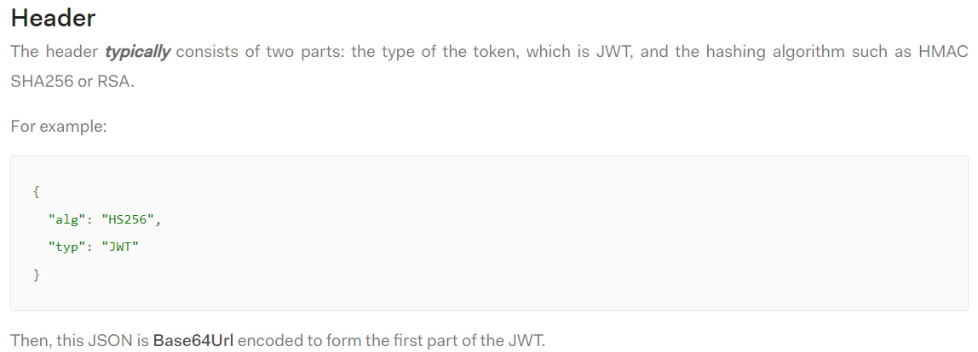

Slide 6



Slide 7
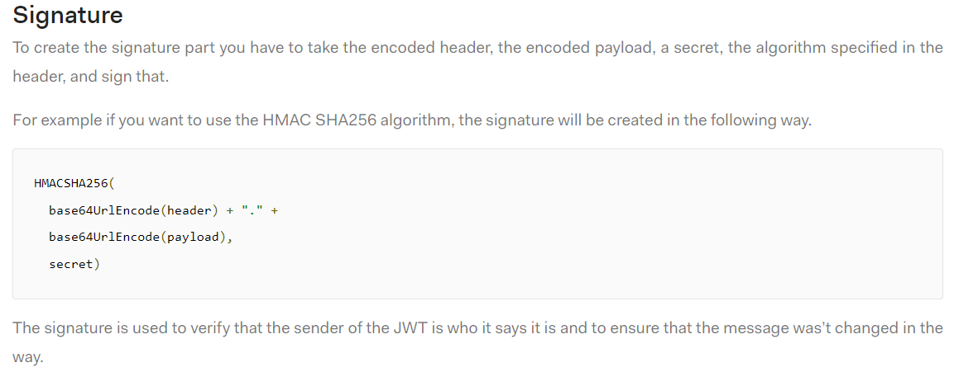

Slide 8
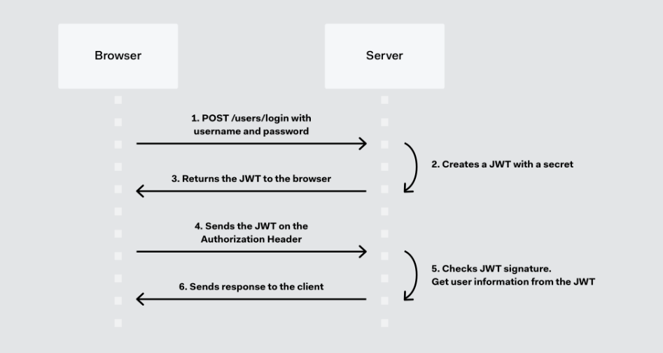
How JWT Work

Slide 9
DEMO

